Slide 1
Prof. Subodh Wagle, IIT Bombay
TD 638: Development Perspectives
Topic D:
Development and Other Key Concepts

Slide 2
Some Key Development-related Concepts

Slide 3
Understanding Development: Different Basic Explanations
Dictionary meaning: ‘development’ as ‘gradual unfolding; fuller working out; growth; evolution. . . ; well-grown state, stage of advancement;
Development = Changes in physical and human conditions (e.g. building roads and improving education provisions, etc.)
Development as fundamental or structural change (a process):
For example: increase in income, removal of slavery or untouchability
Development as an intervention or action aimed at improvement,
regardless of whether betterment is in cat actually achieved. For example: building a road
Development as improvement, with good as the outcome. For example: reduction in malnutrition of tribal children
Development as a platform for improvement, encompassing changes
that will facilitate development in future. For example: Setting up IITs, which will train engineers.

Slide 4
Development = Economic Growth
Economic Growth = Growth of the economy (of a country) over a prolonged period of time.
= Growth in the value of production of goods and services produced in a national economy.
Measured as Increase in GDP = Increase in Gross Domestic Product
= Increase in Total value of goods and services produced by a national economy.
GDP per Capita = GDP / [Total Population of Country]
= Indicator (or Comparator) of development (= production capacity) in a country
Growth in GDP is caused by increases in production in agriculture, industries, natural resource extraction, of other sectors.
Difference between High GDP and High Growth Rate (Rich countries often have lower but stable growth rates)
Limitation = GDP per Capita is average; Every citizen does not have income equal to GDP/ Capita

Slide 5
Distribution of Income = Income Inequality . . . 1
Limitation = GDP per Capita is average; Every citizen does not have income equal to GDP/ Capita
Distribution of Income = Income Inequality = How GDP is distributed among the citizens of country.
= How many poor people there are in a given country and how poor are they?
= Who are benefitting from economic growth (and by how much) and who are not (and by how much) ?
Societies in developing countries tend to be much more unequal than societies in developed countries
Simple measure for Income inequality = Comparison of the income earned by different strata of population
Divide population into five or ten equally populous strata, known respectively as “quintiles” or “deciles,”
Compare the average incomes of these different strata with each other.
Standard comparison: Between the earnings of the wealthiest 20 % (9th & 10th decile or 5th quintile)
and the poorest 40 % (1st to 4th deciles or first two quintiles).

Slide 6
Distribution of Income = Income Inequality . . . 2
Income inequality makes the task of raising people out of poverty even more difficult
This led to the focus of development efforts on “growth with equity” and “targeted social spending”,
= Combining goal of GDP growth with the goal of distributing the benefits of that growth among poor.
Growth remains important because it “grows the (total) pie,” but it is not enough in itself.
Countries that grow faster do not always reduce income inequality automatically (Brazil, India)
Some countries with low growth rates and low GDP/Capita
may succeed in reducing income inequality (Cuba and Kerala)
High GDP growth is not strictly necessary (and not sufficient) for poverty reduction, although it may make it easier.
Poorest and those who are least likely to benefit from the “trickle down” of growth
are usually those who belong to disadvantaged ethnic, linguistic, and cultural groups (issue of intersectionality).

Slide 7
Distribution of Income = Income Inequality . . . 3
Some Implications of Income Inequality
Income Inequality undermines the opportunities for material advancement of the poor,
Income Inequality also has broader cultural effects on the rich turning them into less sensitive to inequality
Being beneficiaries of inequality, rich turn more resistant to changes required for development of country
Income Inequality also undermines the broad and diffused social trust in a society and social capital
Social capital = extent to which individuals are willing to cooperate in the pursuit of shared goals
Essential to the development of a civic and democratic culture.

Slide 8
Distribution of Income = Income Inequality . . . 4
Income Inequality is a common feature of most developing countries: Reasons:
Impact of colonial rule or neo-colonialism
May have forged or consolidated unequal social relations based on slavery, feudalism, landownership patterns developed during colonialism/ due to neo-colonialism, which continue to influence present
Use of inappropriate capital-intensive technology [a characteristics of late industrialization]
Led to reduction in the employment potential of GDP (economic) growth
Inadequate or non-existent social safety nets and regressive taxation systems
which prevent the redistribution of national income toward the poor and middle classes,
Although income inequality makes development more difficult, it is not impossible to overcome.
Through expansion of targeted poverty reduction and broad-based social programs

Slide 9
Poverty
Poverty [difficult to define] = Extremely low levels of income.
Absolute Poverty = below the minimum level of income required for physical survival.
= Defined in 2015 by the World Bank as US$ 1.90 per day per person measured in 2011 dollars at international purchasing power parity (i.e., adjusted for the buying power of a US dollar in the local market).
Moderate Poverty = a level at which basic human needs are barely met
but survival is not actually threatened. [Current Measure = Income of US$3.20 per day]
World Bank reported that 736 million people were below the absolute poverty line in 2015
approximately 10% of world’s population, but much less than 1.85 billion people (36%) in 1990

Slide 10
Multi-dimensional Poverty
Relative Poverty = a kind of poverty that does not threaten daily survival [Defined in the context of USA]
but in which an individual may not have the income necessary to fully participate in his or her society
So, Poverty is not only low income levels; it also has social, political, psychological, and moral elements.
It exists in developing as well as developed countries.
Multi-Dimensional Poverty
Poverty is not just about income levels; it also has social, political, psychological, and moral elements,
which are intricately linked with income levels (e.g., social or gender discrimination in jobs or service provision)
Hence, alleviating poverty or doing development is much more complicated
than simply spurring economic growth or even reducing income poverty.
Thus, Poverty and development are multi-dimensional

Slide 11
Modernity/ Modernization . . . 1
Modernity [Broadest Sense] = condition of being modern, new, or up-to-date.
Assumption = There were (and even are) societies having pre-industrial economies (based on artisanal production), pre-modern (religion-dominated) or traditional cultures everywhere;
every society should progress into modernity (which is by definition a higher/ better stage)
by coming out of this pre-modern stage
Modernity [Specific Use] particular forms of economy and society that were historically adopted by the Modern-Western Europe (as against the social and economic structures in traditional, pre-industrial societies elsewhere)
Modernity [Economic Terms] = encompasses industrialization, urbanization, and the increased use of technology within all sectors of the economy (as against traditional subsistence-based pre-industrial economies).
Modernity [Knowledge Terms] = Rational, secular, and scientific approaches to understanding the world and progress.
This was contrasted with understandings rooted in religious/ spiritual/ mystic/other-wordly explanations and understanding accepted in traditional, pre-modern societies

Slide 12
Modernity/ Modernization . . . 2
Modernity [Socio-Cultural Terms] Values and institutions adopted by Modern-Western Europe based on modern scientific temperament.
Indicators of Modernization = Transformations:
(i) In Technology: Traditional to Modern-Western,
(ii) In Economies: Pre-Industrial to Industrialized,
(iii) In Belief Systems, Education: Spiritual/ Religious to Rational, Secular
(iv) In Cultural Norms: Traditional to Modern-Western,
(v) In Social Systems: Joint Family, Kinship, Caste based to Nuclear Family and Urban Cosmopolitan,
(vi) In Political System: Monarchy, Fiefdoms to Liberal Democracy with Universal Suffrage

Slide 13
Modernity/ Modernization . . . 3
Diffusion of modernity in traditional societies will automatically bring in Development and Progress.
Hence, modernity is equal to Development and Progress
Main Critique of Idea of Modernity
Singular understanding of Modernity (= economic/ social forms in Modern-Western Europe after 18th century) is problematic
Implicit denigration (insult) of economies and societies in other parts of the world
by calling them as pre-industrial and pre-modern is also problematic
Pursuit of modernity caused decline of ‘traditional’ institutions and cultures, environment, quality of life in other parts of world.
Dynamic Nature of Modernity: Due to social, economic, political and cultural changes,
what is ‘modern’ should change temporally and spatially.
What is ‘modern’ in one place may be ‘old-fashioned’ elsewhere.

Slide 14
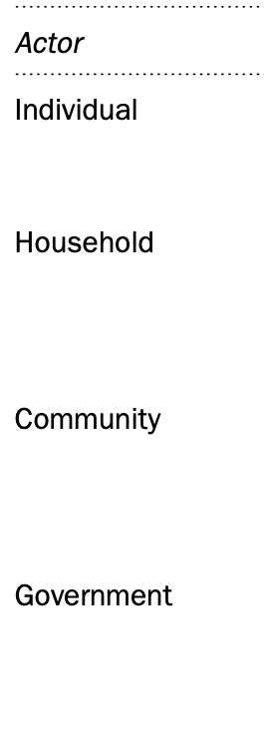
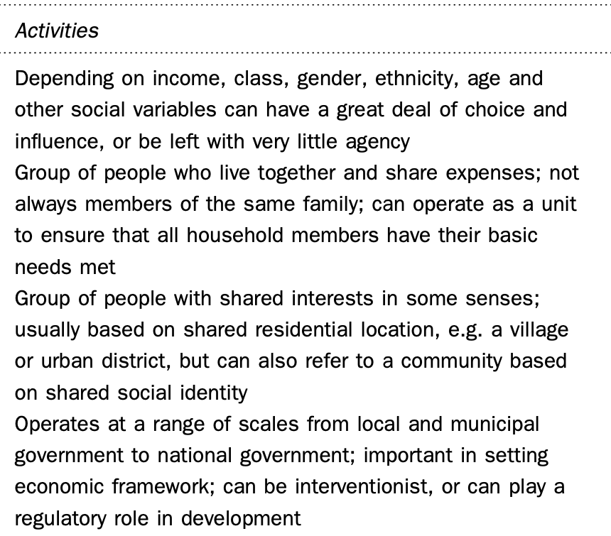
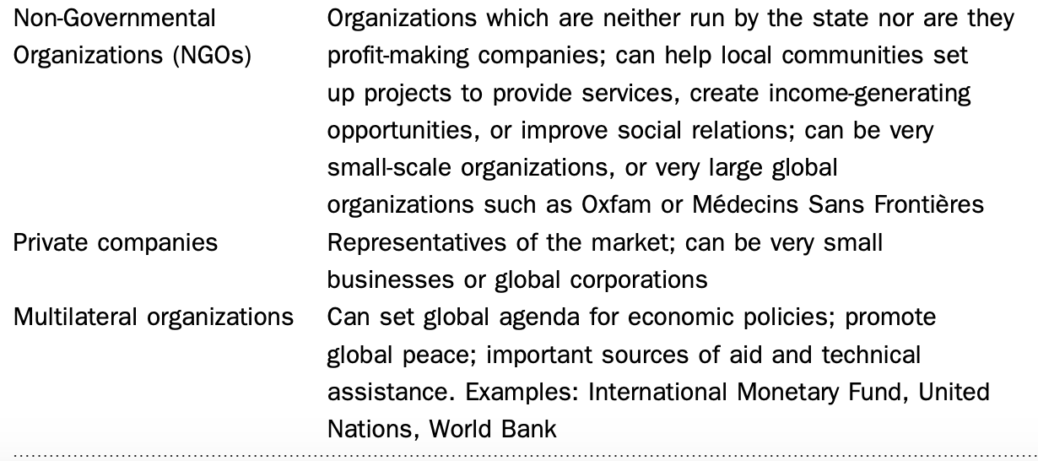

Actors in Development

Slide 15
Labeling of Countries

Slide 16
Labeling of Countries . . . 1
Third World : Suggested by French Demographer Sauvy in 1952
Rooted in concept of “Third Estate” = Bottom Layer of Social Pyramid in the pre-revolutionary France.
“Third Estate” = Excluded from the First two Estates or Top Layers of Clergy and Nobility.
Comprised heterogenous mix of social groups (from slaves to merchants)
Similarly, Third World a heterogenous mix of countries, following different developmental paths but are not in:
First World (American Block or NATO countries: USA and western European countries) AND
Second World (Soviet-Block comprising USSR and East European Countries)
Third World: No objective criteria to define, but seen as pejorative, hierarchical
and hence demeaning and patronizing term that has connotation of ‘poor, under-developed countries’

Slide 17
Labeling of Countries . . . 2
Developing Countries or Developed World or Developing Economies
Less pejorative and apparently neutral term, some found it “optimistic”
Seen as improvement over old term under-developed regions or areas (not countries which did not count)
But when used in conjunction with the related term of Developed Countries/ World,
the hierarchical order becomes apparent
Newly Industrializing Countries (NICs)
In 1970s, some countries from “developing world” saw economic transformation
These included: Hong Kong, South Korea, Singapore, Taiwan

Slide 18
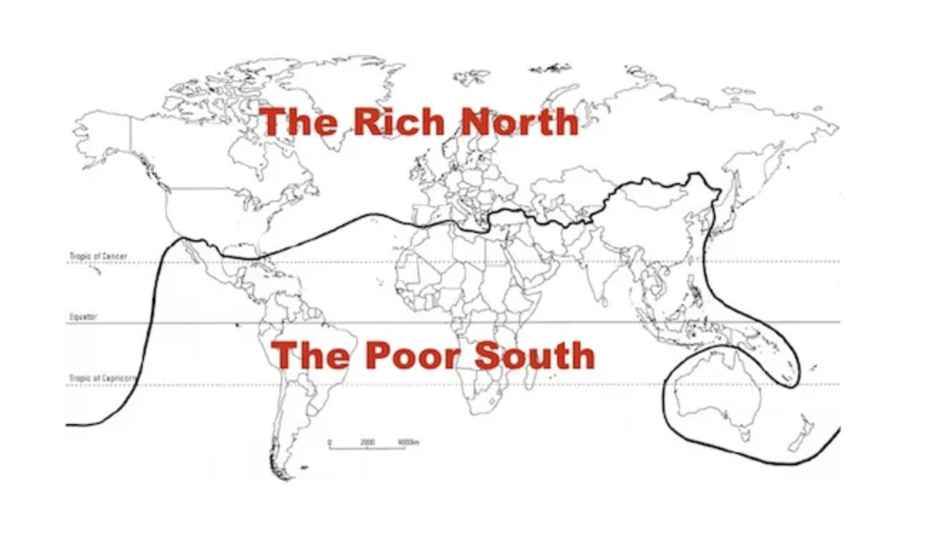
Labeling of Countries 3: Brandt Line Global North and Global South

Slide 19
Labeling of Countries . . . 4
Emerging Markets
After 1990s, Title given by the global capitalist enterprises
indicating readiness of these countries to join the global markets
due to their acceptance of economic reforms
Reflecting approval of global capitalist enterprise and
Reflecting optimism for futures of these countries,
absent in terms such as Third World or under-developed

Slide 20
Labeling of Countries . . . 5
Two-Thirds World or Majority World
These are the alternative terms coined
In response to pejorative, hierarchical, demeaning terms like “Third World” Under-developed regions”
The South or the Global South (Related Term: the Global North)
Less pejorative as they indicate the geographic location (Southern Hemisphere) of (most) these countries
Could also be seen as countries as worthy of receiving or not giving international aid
Exceptions: Australia, New Zealand, Singapore and some counties in Northern Hemisphere receiving aid
These terms allow derivative terms like: “North in the South” and “South in the North”

Slide 21
Labeling of Countries . . . 6
Fourth World
One connotation suggested by Canadian Aboriginal leader George Manuel (1970s)
Areas of internal colonization by European settlers (Canada, USA, Australia, New Zealand)
Referring to aboriginal populations in these areas and
Emphasizing dispossession of their lands and natural resources
And abrogation of their political economic, social, and cultural rights
Another recent usage: referring to the poorest of poor countries or “failed states”
which are suffering acute poverty and deprivation due to armed conflicts
Such as Somalia, Afghanistan, Libya, Sudan

Slide 22
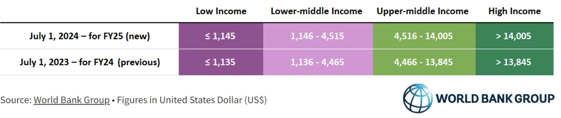
Labeling of Countries . . . 7
World Bank (Economic) Categorization of Countries (Economies)
Classification into Four Groups: Economic Classification based on Gross National Income (Atlas Method) Per Capita
The threshold (boundaries) of the four groups are revised every year in July.
Threshold Values for the last two years
India’s GNI per capita in 2023 was US $ 2450 per capita

Slide 23
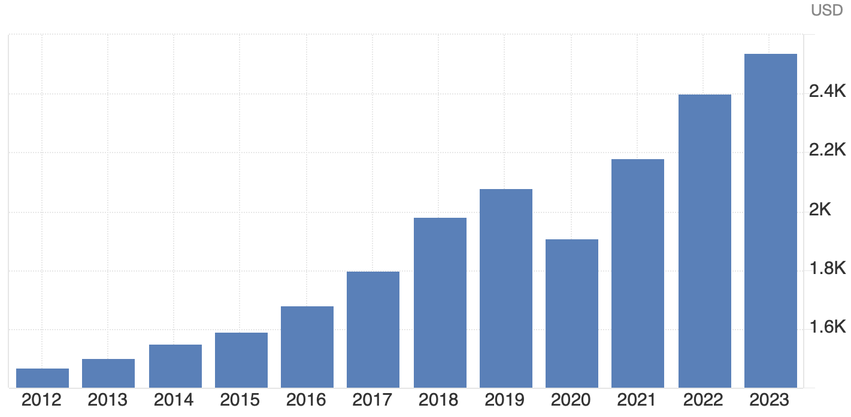
Labeling of Countries . . . 8
World Bank (Economic) Categorization of Countries (Economies)
Check this link, you can get GNI per capita for all countries every year since 1987
https://tradingeconomics.com/india/gni-per-capita-atlas-method-us-dollar-wb-data.html
India’s GNI per Capita since 2012

Slide 24
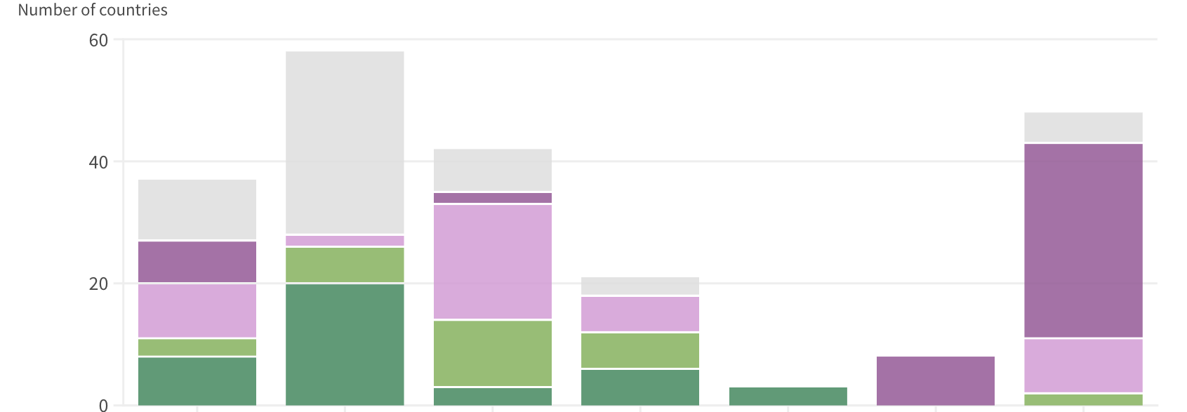
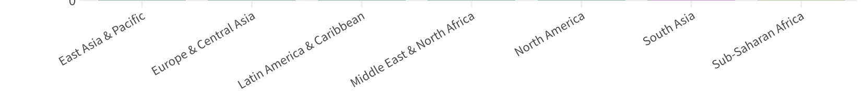
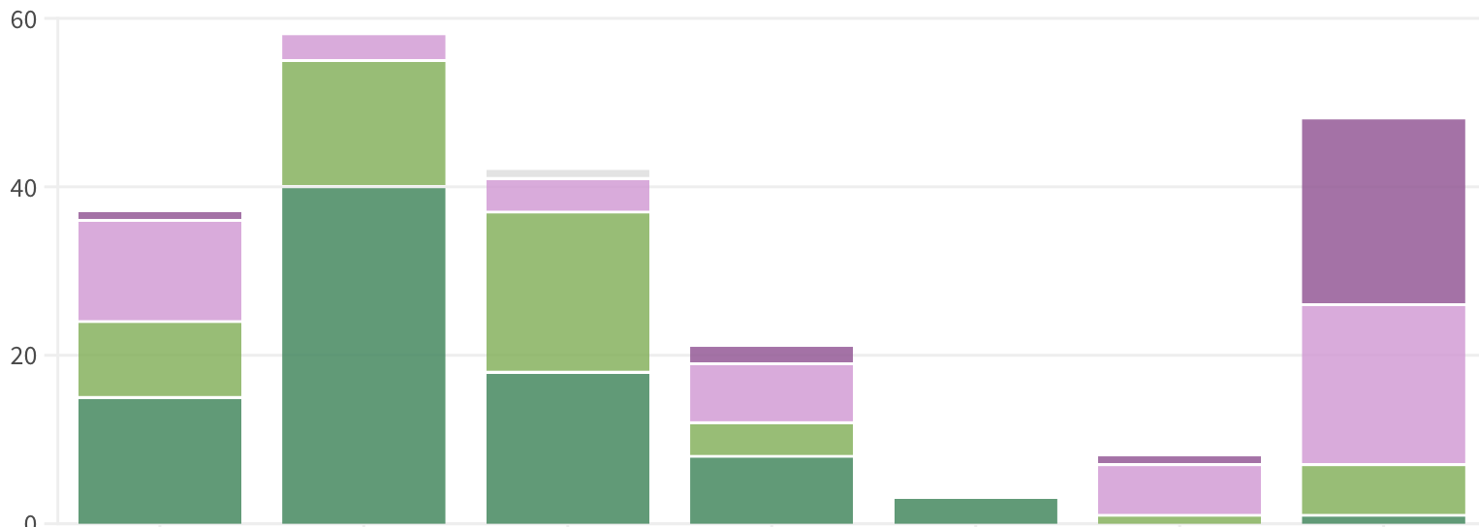
Labeling of Countries . . . 8: World Bank GNI/Capita Categories
1987
2023

Slide 25
Population and Development

Slide 26
High and Low Death Rate and Population Growth
Death Rates largely depend on physical factors like low food availability due to draughts or floods, Natural calamities, low nutrition levels, diseases.
Death Rates can be reduced by
improvements in sanitation improve public health,
the spread of vaccines modern medicines to reduce deaths due to diseases,
the use of insecticides to protect crops and use of chemical fertilizers to increase agricultural productivity;
all these improve general living standards.
High Death Rates reduce Population. Low Death Rate Increases Population

Slide 27
High and Low Birth Rate and Population Growth
Birth-rates governed by social factors such as education, empowerment of women, economic security.
Parents derive considerable economic benefits from having many children
e.g., provision of direct family labour, insurance against risk, and support in old age.
However, the economic costs incurred in bearing and rearing children get neglected.
The physical and psychological costs suffered by women in childbearing and child-rearing
remain neglected due to patriarchal traditions.
However, education, particularly of women lead to a reduction in Fertility Rates because of factors like
late marriages, greater uptake of contraception, and consequently lower fertility rate (and child mortality)
High Birth Rates increases Population. Low Birth Rate decreases Population

Slide 28
Population and Development: Demographic Transition . .1
Population Growth and Development are seen by many as interdependent phenomena.
One theory about their interrelationship is called Demographic Transition.
Decline in Death Rate occurs before the Decline in Birth Rate begins
Hence, Birth Rate Exceeds Death Rate by Unusual Degree during Transition:
Resulting in High Growth Rate of Population
High and Roughly Equal Birth Rate and Death Rate, leading to
Low Growth Rate of Population
Low and Roughly Equal Birth Rate and Death Rate
leading to
Low Growth Rate of Population
.
Pre-Development Conditions
Conditions after Development
Conditions During Development

Slide 29
Population and Development: Demographic Transition . .2
In Developed (Rich) Countries:
Death rates declined gradually because all the factors leading to this decline
were largely endogenous to those countries (= evolved internally and also gradually)
Birth rates also declined gradually.
As a result, population growth rates were fairly modest (mostly </= 1.5 %).
In Developing (Poor) Countries:
Death rates declined rapidly because of fast introduction of modern science & technological measures to reduce deaths
Birth-rates however declined gradually for long periods.
As a result, population growth rates remained fairly high for a long time,
resulting in very high population numbers that remained stable for long period.

Slide 30
Development Consequences of Large & Expanding Populations
Some believed: Large and Rapidly Expanding populations have net positive effect on economic growth
Some Developing Countries managed to maintain high rate of economic growth
despite high population growth rate,
especially those who managed to reduce their birth rates faster than others (East-Asian) .
Most believed: Large and Rapidly Expanding populations affected economic growth adversely,
leaving many countries in the poverty trap for long time.
Mainly because: Large and Rapidly Expanding populations pose serious challenges for the provision of basic services and facilities – like education, employment, healthcare, housing and fresh water.
Environmental Impact: Large and Rapidly Expanding populations require large pool of natural resources,
and hence cause irreparable damage to environment

Slide 31
Thank You

